Slide 1

Data Visualization
Risman Adnan, Ph.D
Telkom University

Slide 2
Outline – Data Visualization
Visualization Fundamentals
From Data to Visualization
Principles of Charts Design
Design guideline for common used charts
Data Visualization Framework
Seaborn, eChart and Bokeh Common Plots
Building Visualization Dashboard
Superset Dashboard Framework

Slide 3
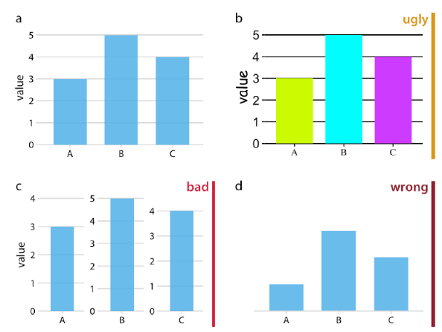
Bad Visualizations are Everywhere
We are Not Good in Visualization!
Visualization = science + art
Aesthetic = systematic + logical
Visualizing = Mapping Data onto Aesthetics!
Key Principles to Avoid:
Understand visualization context
Choose an appropriate visual display
Eliminate clutter
Focus attention where you want it
Think like a designer
Tell a story (the purpose is insights)

Slide 4
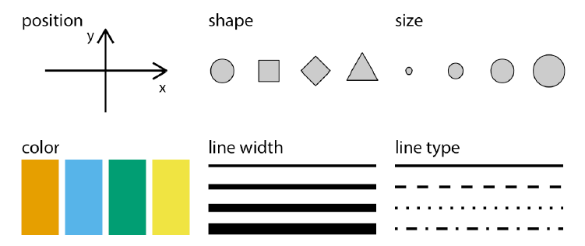
Basic Aesthetics

Slide 5
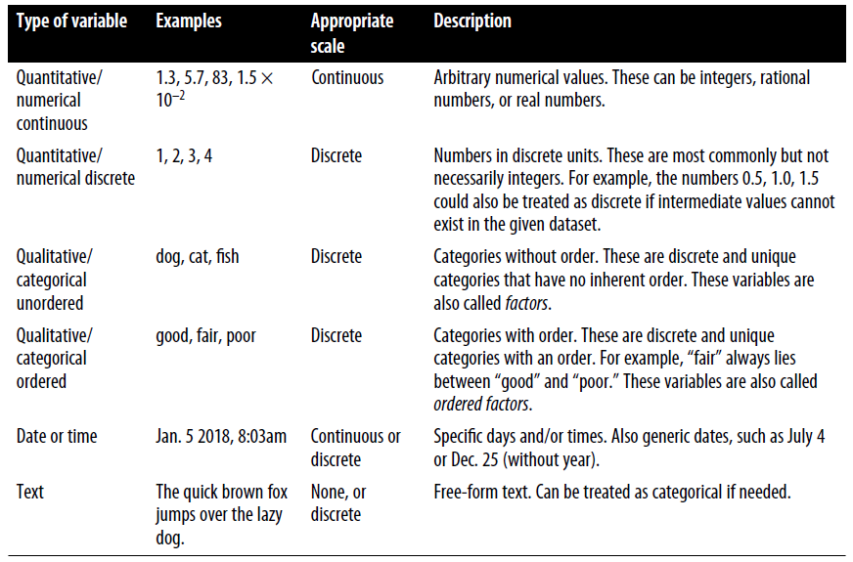
Data Types
Major Types:
Numerical
Categorical
Date Time
Text
Geospatial
Probability

Slide 6
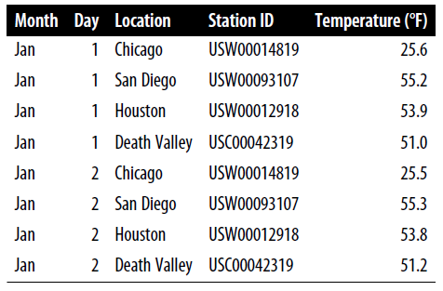
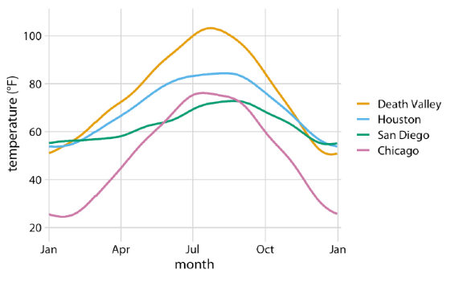
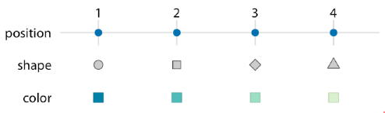
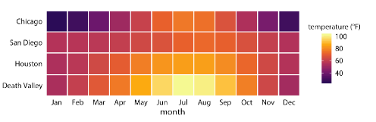
Example: US Temperature NOAA Data

Slide 7
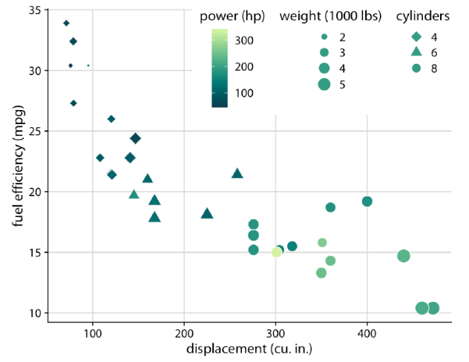
Example: Cars Fuel Efficiency
5 scales to describe data:
x axis (displacement);
y axis(fuel efficiency);
Color of data (power)
Size of data (weight);
Shape of (# of cylinders).

Slide 8
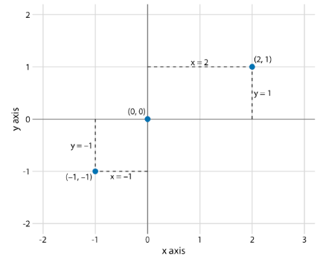
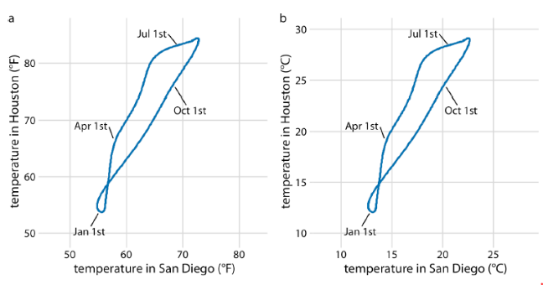
Coordinate System Axes
Cartesian Coordinates

Slide 9
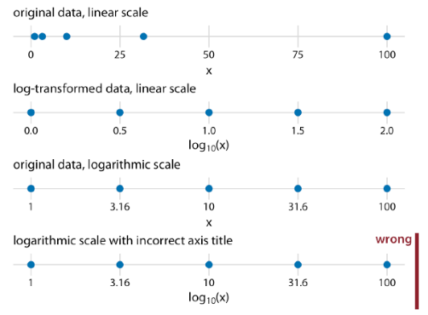
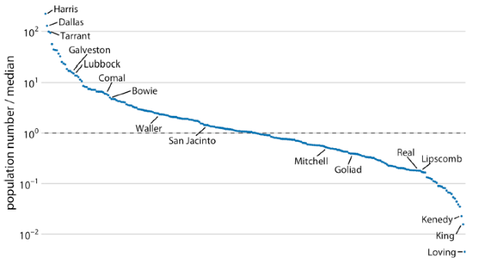
Coordinate System Axes
Non-Linear Axes

Slide 10
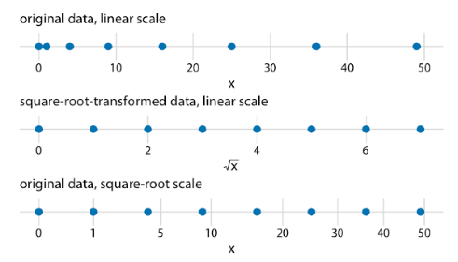
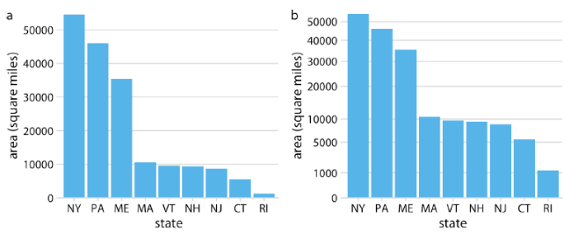
Coordinate System Axes
Square Root Axes

Slide 11
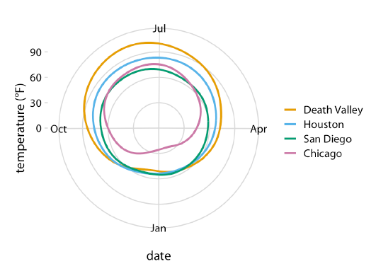
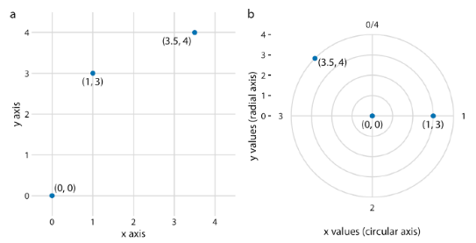
Coordinate System Axes
Circular Axes

Slide 12
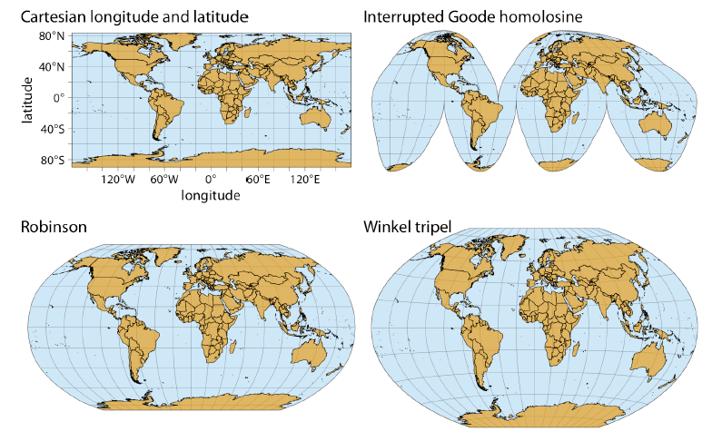
Example: Map of the World

Slide 13
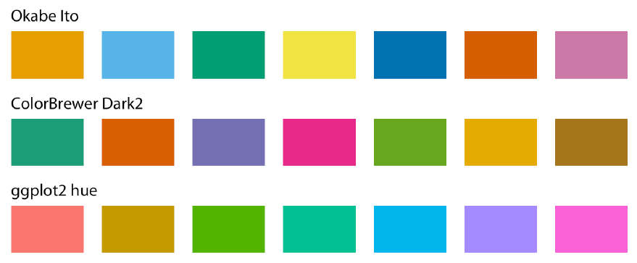
Color Scales
Colors to distinguish groups of data from each other, to represent data values, and to highlight.
In this case, we use standard qualitative color scale. Many of them available in community.

Slide 14
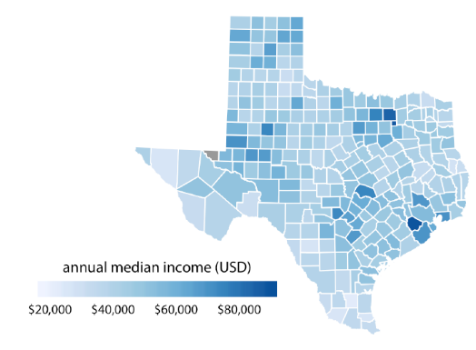
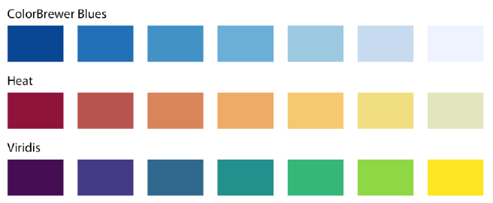
Color Scales
Represent Data Values

Slide 15
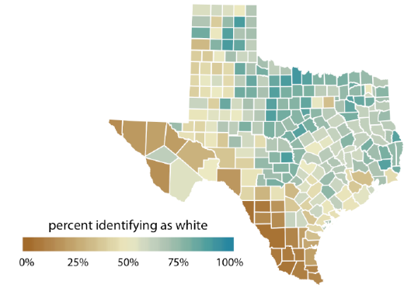
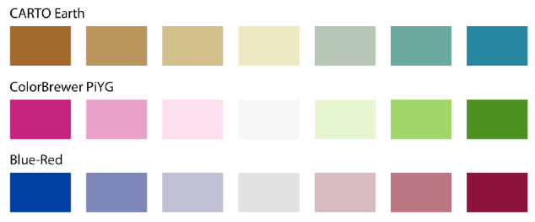
Color Scales
Diverging Data Values

Slide 16
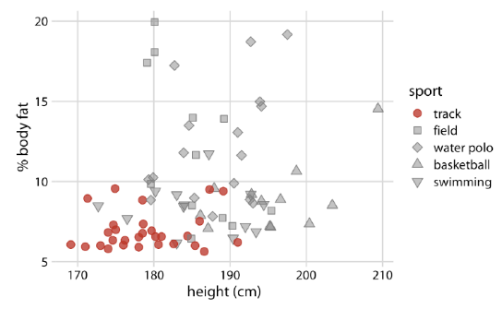
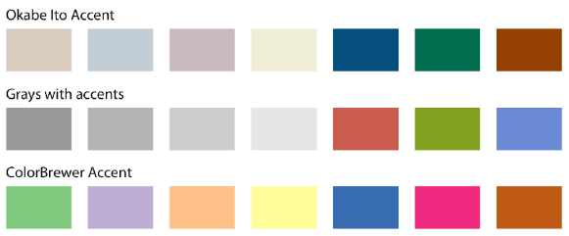
Color Scales
Color to Highlight

Slide 17
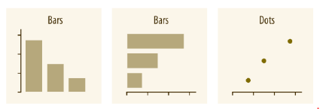
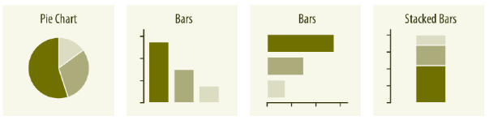
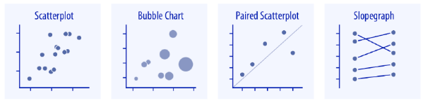
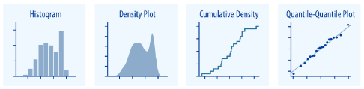
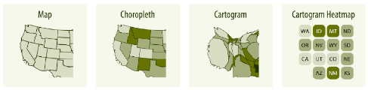
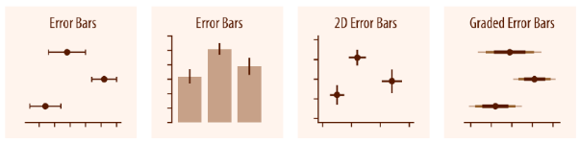
Directory of Visualizations
Amount
Proportion
Distribution
X-Y Relationship
Geospatial
Uncertainty

Slide 18
Outline – Data Visualization
Visualization Fundamentals
From Data to Visualization
Principles of Charts Design
Design guideline for common used charts
Data Visualization Framework
Seaborn, eChart and Bokeh Common Plots
Building Visualization Dashboard
Superset Dashboard Framework

Slide 19
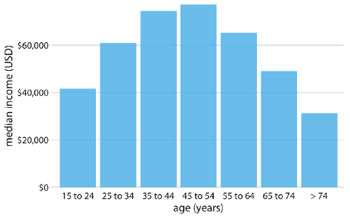
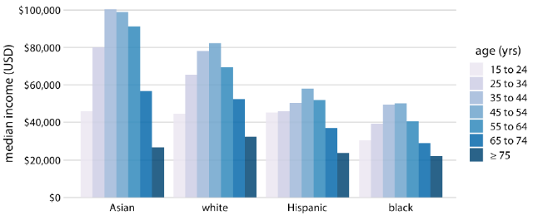
Visualizing Amounts
We are interested in the magnitude of some set of numbers.
Samples of visualization: Bar and Stacked Bars

Slide 20
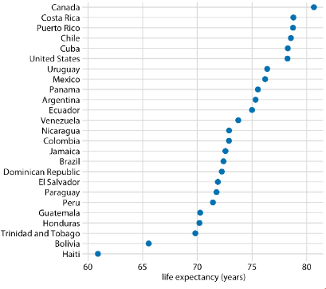
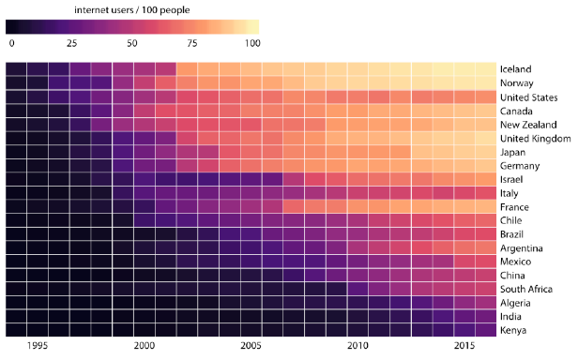
Visualizing Amounts
Samples of visualization: Dot plot and Heatmap

Slide 21
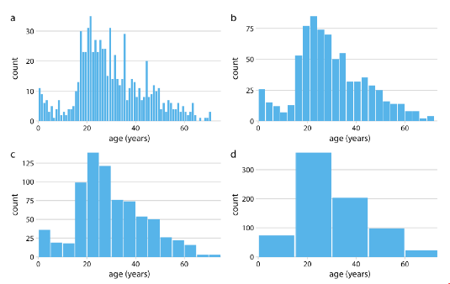
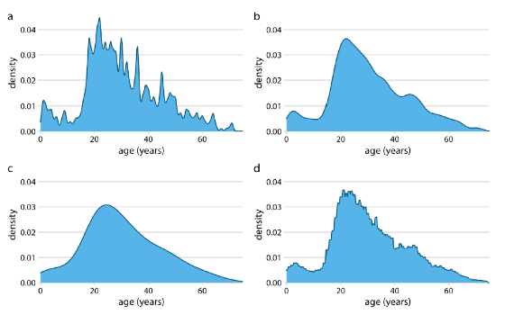
Visualizing Distributions
Understand how a particular variable is distributed in a dataset.
Sample of visualization: Histograms and Density Plots

Slide 22
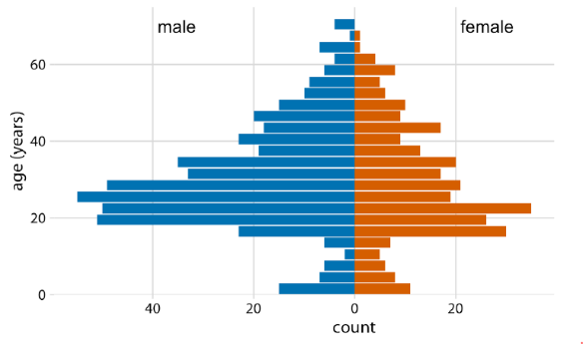
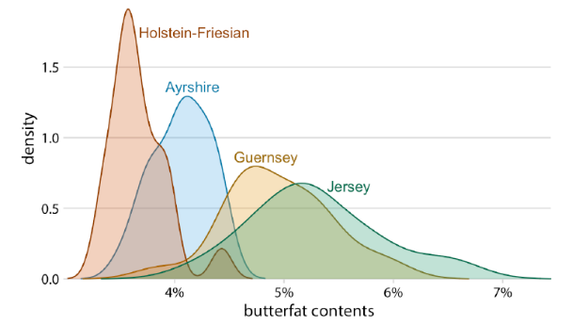
Visualizing Distributions
Sample of visualization: Multiple Distributions

Slide 23
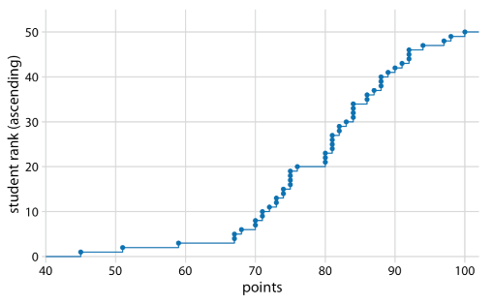
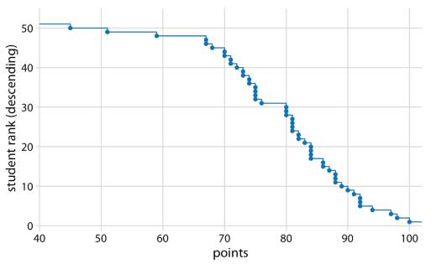
Visualizing Distributions
Empirical cumulative distribution functions (ECDFs), no arbitrary parameter choices, and they show all of the data at once.

Slide 24
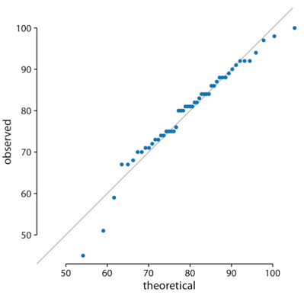
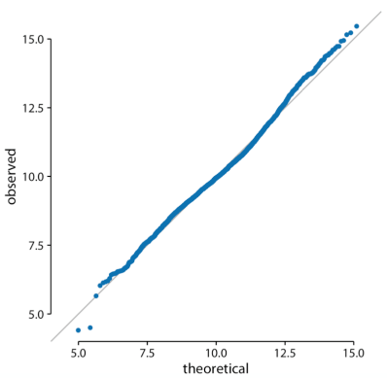
Visualizing Distributions
Quantile-quantile (q-q) plots are useful when we want to determine to what extent the observed data points do or do not follow a given distribution.

Slide 25
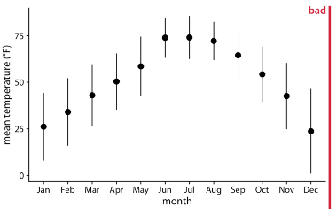
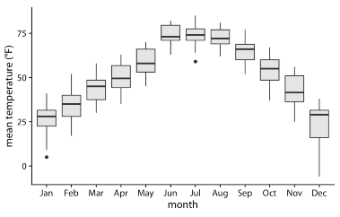
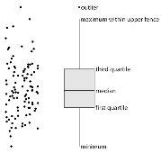
Visualizing Many Distributions at Once
Think in terms of the response variable and one or more grouping variables. The response variable is the variable whose distributions we want to show. The grouping variables define subsets of the data with distinct distributions of the response variable. Sample: Boxplot.

Slide 26
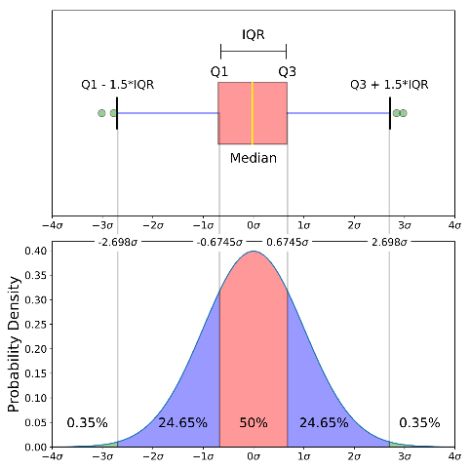
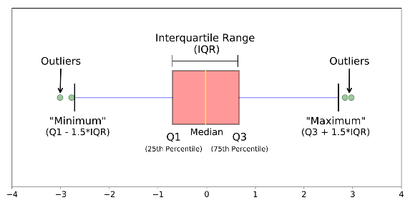
Boxplot Definition
Show distributions by depicting groups of numerical data through quartiles.

Slide 27
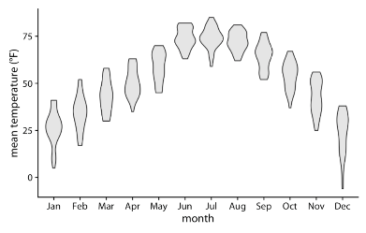
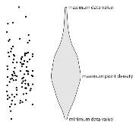
Visualizing Many Distributions at Once
Violins can be used whenever one would other‐wise use a boxplot.
Violin plots will accurately represent bimodal data whereas a boxplot will not.

Slide 28
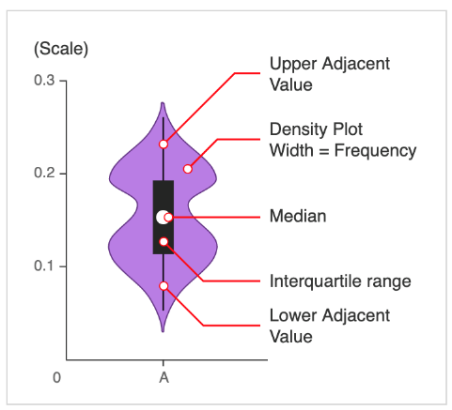

Violin Plot Definition
Visualize the distribution and its probability density = boxplot + density plot.

Slide 29


Ridgeline Plot Definition
It looks like mountain ridgeline ☺. Use it to show trends of distribution over time.

Slide 30



Visualizing Proportions
Looks simple, but visualizing proportions can be challenging, in particular when the whole is broken into many different pieces or when we want to see changes in proportions over time or across conditions.

Slide 31

Visualizing Proportions
There is no single ideal visualization that always works.

Slide 32



Visualizing Proportions
Side-by-side bars case.

Slide 33



Visualizing Proportions
Case of Stacked Densities

Slide 34


Visualizing Nested Proportions
Nested proportions, because each additional categorical variable that we add creates a finer subdivision of the data nested within the previous proportions.

Slide 35


Visualizing Nested Proportions
We can use nested map, but it is not intuitive to understand.

Slide 36


Visualizing Nested Proportions
There are several suitable approaches to visualize such nested proportions, including mosaic plots and treemaps below.

Slide 37


Visualizing Nested Proportions
Mosaic plots, treemaps, and pie charts are OK, but choice is parallel sets plot.

Slide 38



Visualizing Associations
Many datasets contain two or more quantitative variables, and we may be interested in how these variables relate to each other. For example, Scatter Plot.

Slide 39


Visualizing Associations
When we have more than three to four quantitative variables, all-against-all scatter‐ plot matrices quickly become unwieldy. In this case, it is more useful to quantify the amount of association between pairs of variables and visualize these quantities rather than the raw data. One common way to do this is to calculate correlation coefficients.

Slide 40


Visualizing Associations
Visualizations of correlation coefficients are called correlograms.

Slide 41


Visualizing Associations
Dimension reduction relies on the key insight that most high-dimensional datasets consist of multiple correlated variables that convey overlapping information. Widely used technique is PCA - Principal Components Analysis.

Slide 42



Visualizing Associations
A special case of multivariate quantitative data is paired data: data where there are two or more measurements of the same quantity under slightly different conditions.

Slide 43




Visualizing Time Series
One of the two variables can be thought of as time which imposes additional structure on the data.
We can arrange the points in order of increasing time and define a predecessor and successor for each data point.

Slide 44



Visualizing Time Series
We often have multiple time curves that we want to show at once. In this case, we have to be more careful in how we plot the data, because the figure can become con‐ fusing or difficult to read.

Slide 45


Visualizing Time Series
It is not unusual, to have more than one response variable. Such situations arise commonly in macroeconomics.

Slide 46


Visualizing Time Series
The trick is to apply dimension reduction first then draw a connected scatterplot in the dimension-reduced space.

Slide 47

Visualizing Trends
There are two fundamental approaches to determining a trend: smoothing (and defined functional trend.
The moving average is the most simplistic approach to smoothing, and it has some obvious limitations.
Statisticians developed numerous approaches to smoothing that alleviate the downsides of moving averages. One widely used method is Locally Estimated Scatterplot Smoothing (LOESS)

Slide 48

Visualizing Trends
LOESS fits low-degree polynomials to subsets of the data. The points in the center of each subset are weighted more heavily than points at the boundaries, and this weighting scheme yields a much smoother result.
LOESS is a popular smoothing approach because it tends to produce results that look right, however, it requires the fitting of many separate regression models.

Slide 49

Visualizing Trends
As a faster alternative is spline models. A spline is a piecewise polynomial function that is highly flexible yet always looks smooth.
There is a bewildering array of different types of splines, including cubic splines, B-splines, thin-plate splines, Gaussian process splines, and many others, and which one to pick may not be obvious.
Most data visualization software will provide smoothing features.

Slide 50





Visualizing Trends
These smoothers also do not provide parameter estimates that have a meaningful interpretation. Therefore, whenever possible, it is preferable to fit a curve with a specific functional form that is appropriate for the data and that uses parameters with clear meaning.

Slide 51


Visualizing Trends
For any time series with a prominent long-term trend, it may be useful to remove this trend to specifically highlight any notable deviations. This technique is called detrending.

Slide 52


Visualizing Trends
What we want to see in time series: long term trend, random noise, external events, cyclical variations. We called this Time Series Decomposition.

Slide 53



Visualizing Geospatial Data
Maps tend to be intuitive to readers, but they can be challenging to design. A common mapping techniques, the choropleth map and cartograms.
Orthographic projection
Mercator projection
Interrupted Goode homolosine projection

Slide 54



Visualizing Geospatial Data
Shape or area distortions due to map projections are particularly prominent when we’re attempting to make a map of the whole world, but they can cause trouble even at the scale of individual continents or countries.
Orthographic projection
Albers projection

Slide 55



Visualizing Geospatial Data
To visualize geospatial data in the proper context, we usually create maps consisting of multiple layers showing different types of information.
Google map with 4 layers
Individual layers
Detail map

Slide 56



Visualizing Geospatial Data
We frequently want to show how some quantity varies across locations. We can do so by coloring individual regions in a map, we called it choropleth maps.

Slide 57



Visualizing Geospatial Data
Not every map-like visualization has to be geographically accurate to be useful. What if we deformed the states so their size was proportional to their number of inhabitants? Such a modified map is called a cartogram.

Slide 58


Visualizing Uncertainty
One of the most challenging aspects of data visualization is the visualization of uncertainty like probability data. Two commonly used approaches to indicate uncertainty are error bars and confidence bands.
Visualizing probability as frequency
Visualizing probability as distribution

Slide 59

Visualizing Uncertainty
We can combine the discrete outcome nature frequency with a continuous distribution using drawing a quantile dot plot.
In the quantile dot plot, we subdivide the total area under the curve into evenly sized units and draw each unit as a circle.
As a general principle, quantile dot plots should use a small to moderate number of dots.

Slide 60


Visualizing Uncertainty
The concept of statistical sampling. The variable of interest that we are studying has some true distribution in the population, with a true population mean and standard deviation.

Slide 61


Visualizing Uncertainty
There are two types of probability interpretations, frequency and bayesian. They use different styles to visualize probabilities.

Slide 62


Visualizing Uncertainty
In case of polynomial curve fitting, we can use confidence band to show uncertainty. It can be combined with curve fit.
Best fit spline and confident band.

Slide 63


Visualizing Uncertainty
Audiences may interpret uncertainty visualization as a deterministic feature. We can avoid this problem by visualizing uncertainty through animation, by cycling through a number of different but equally likely plots, this called a hypothetical outcome plot (HOP).

Slide 64

Some Key Principles
Proportional Ink
Handling Overlapping Points
Common Pitfalls of Color Use
Redundant Coding
Multipanel Figures
Title, Captions and Tables
Balance the Data and the Context
Use Larger Axis Labels
Avoid Line Drawing
Don’t go 3D

Slide 65
Outline – Data Visualization
Visualization Fundamentals
From Data to Visualization
Principles of Charts Design
Design guideline for common used charts
Data Visualization Framework
Seaborn, eChart and Bokeh Common Plots
Building Visualization Dashboard
Superset Dashboard Framework

Slide 66
Seaborn Framework
Data visualization library based on matplotlib, closely integrated with Pandas.
Here is some of the functionality that seaborn offers:
Dataset-oriented API for examining relationships between multiple variables
Support categorical variables to show observations or aggregate statistics
Options for visualizing univariate or bivariate distributions
Automatic estimation and plotting of linear regression models
Convenient views onto the overall structure of complex datasets
High-level abstractions for structuring multi-plot grids
Concise control over matplotlib figure styling with several built-in themes
Tools for choosing color palettes that faithfully reveal patterns in your data

Slide 67

How to Learn Seaborn Framework

Slide 68


Common Examples
Please see gallery: https://seaborn.pydata.org/examples/index.html

Slide 69

eChart Framework

Slide 70

Bokeh Framework
Bokeh is an interactive visualization library, its goal is to provide elegant, concise construction of versatile graphics, and to extend this capability with high-performance interactivity over very large or streaming datasets.

Slide 71
Outline – Data Visualization
Visualization Fundamentals
From Data to Visualization
Principles of Charts Design
Design guideline for common used charts
Data Visualization Framework
Seaborn, eChart and Bokeh Common Plots
Building Visualization Dashboard
Superset Dashboard Framework

Slide 72

Introduction to Superset

Slide 73

THANKS
Please work on your homework

